Slide 1
By:
Albaqir Mohammed Ibrahim
Zahraa Khalid Farhaan
Dania Rafid Hussein
Fatima Naseer Abd Al-Jabbar
Supervised by:
Dr. Hussein Khudair Hussein
2023/1444

Slide 2
Introduction
The incidence of AOP is inversely correlated with gestational age and birth weight. Seven percent of neonates born at 34 to 35 weeks gestation, 15% at 32 to 33 weeks, 54% at 30 to 31 weeks [1], and nearly all infants born at <29 weeks gestation or <1,000 g exhibit AOP [2]. It is generally broken down into three subtypes: central, obstructive, or mixed [3]. Central apnea accounts for approximately 10% to 25% of all cases of apnea, with obstructive apnea accounting for 10% to 25% and mixed for 50% to 75%. In each individual infant, one of these subtypes tends to predominate [3].

Slide 3
Pathogenesis:
AOP likely reflects a “physiological” rather than a “pathological” immature state of respiratory control.
Fetal to neonatal transition :
The postnatal rise in PaO2 effectively silences peripheral chemoreceptors, resulting in delayed onset of spontaneous breathing.

Slide 4
Ventilatory response to hypoxia: increase in respiratory rate and tidal volume that lasts for 1–2 min, followed by a late, sustained decline in spontaneous breathing that may last for several weeks This late decline in spontaneous breathing is termed hypoxic ventilatory depression
Ventilatory response to hypercapnia:
premature infants increase ventilation by prolonging the period of expiration, but not increasing breath frequency or overall tidal volume, leading to less minute ventilation than that seen in term infants.
Ventilatory responses to laryngeal chemoreflex:
Activation of the laryngeal mucosa in premature infants can lead to apnea, bradycardia, and hypotension

Slide 5
Neurotransmitters and apnea:
adenosine receptors are expressed in GABA-containing neurons. The binding of adenosine to its receptor may be involved with the release of GABA and thus inhibit respiration leading to apnea
Genetic variability and apnea:
researchers found that the heritability of AOP was 87% among same-gender twins . These findings raise the possibility that AOP has an important genetic basis.

Slide 6
Consequences of AOP:
Short-term consequences:In premature infants, desaturation and bradycardic episodes often occur along with apnea.
Long-term consequences:It is difficult to prove a link between apnea and poor neurodevelopmental outcomes due to the possible coexistence of neurological injury in premature infants.

Slide 7
Methods:
Study type:
Setting and duration
Duration:
Inclusion criteria
Exclusion criteria:
Study population:

Slide 8
Study sample, sampling method, size of control group if present:
Retrospective study, Available medical records of children admitted to the Neonatal Intensive Care Unit involving 2021 and 2022.
Permission obtained from Al-kindy college of medicine by administrative order directed to Neonatal Intensive Care unit at Al-Elwiya hospital for pediatric to facilitate the task of obtaining the information.

Slide 9
Method of data collection :
The Study involved 120 premature infants aged between (1-15) days old, but only 90 of them met our criteria. data were collected from patients’ records in Neonatal Intensive Care Unit, data include recording information regarding (gender, age, weight, the day of treatment start, delivery method, treatment used and the result)
Age was divided into three categories
Weight divided into three categories

Slide 10
Statistical methods:
Data has been performed through EXCEL and SSPS program version 17 and. Qui square test applied looking for a more significant treatment between Caffeine and Theophylline. p value=0.05 was considered as cut off point for level of significance.

Slide 11
Results
Table 1: frequency distribution of studied cases according to study variables:

Slide 12
Table 2: Weight distribution in study sample.

Slide 13
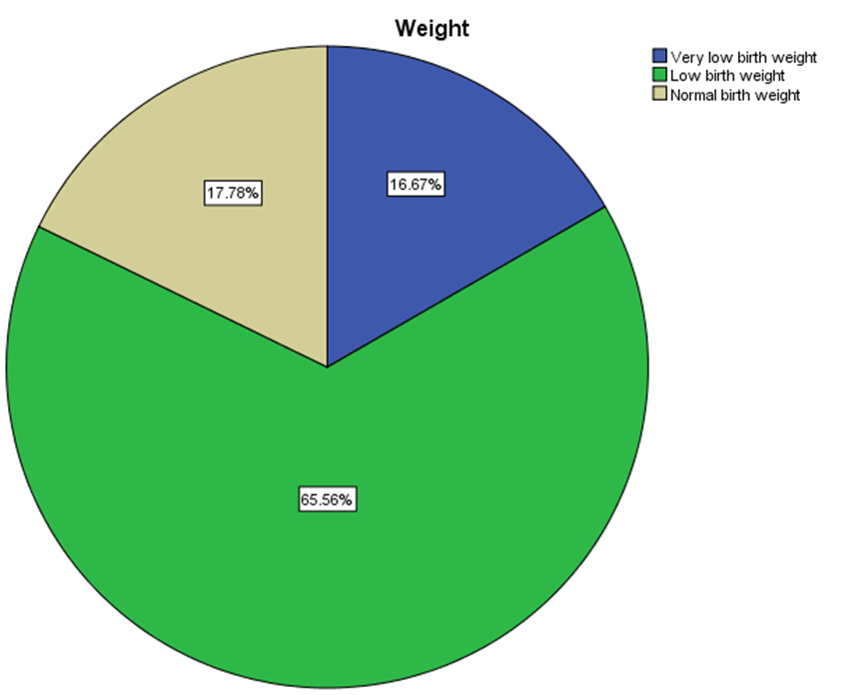
Figure 1: Weight distribution in this study

Slide 15
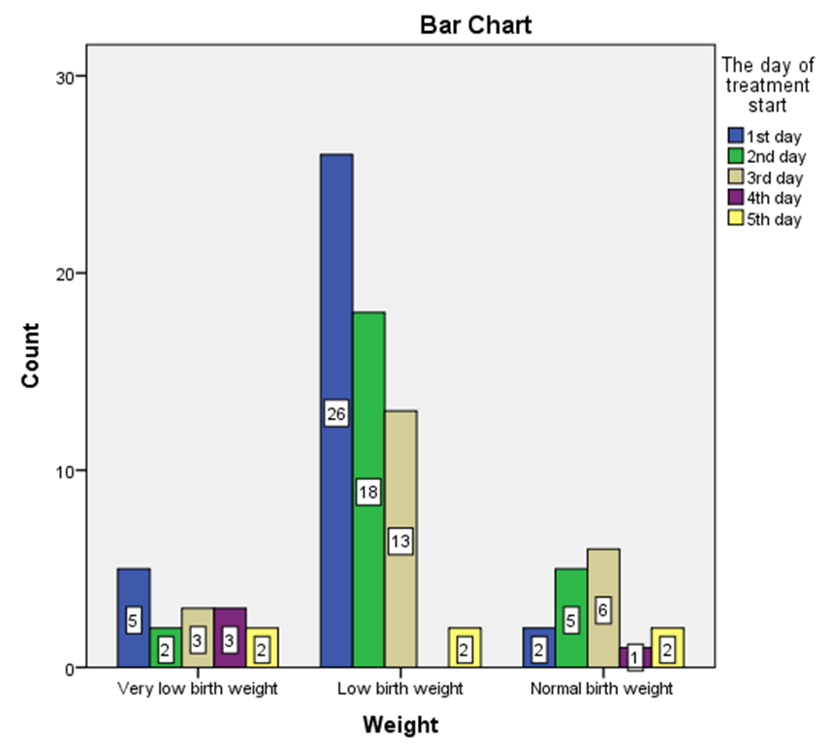
Figure 2: Weight distribution in each day of treatment start

Slide 16
Table 3: Association between the used medication and gender, age and results.

Slide 17
Discussion
Study conducted by Natarajan G et al
Maria S, et al
In 2015 Jeong Ket al
In a study conducted by Mohammed Set al
Henderson-Smart DJ, et al
Steer PA, et al and Markantonis SL

Slide 18
Conclusion
Results of our study revealed that caffeine is a bit more effective than aminophylline in treatment of apnea of prematurity.
The percentages of patients who admitted with a gestational age of (1-5) days were a bit superior.
The association between the weight and the day of treatment start is significant that the number of patients with low birth weight were more than other groups.

Slide 19
Recommendation
This a retrospective study ,so the needs for prospective study my change the results.
This study highlight the importance of close following up the newborn , specially the preterm to prevent the short and long tem complications

